Slide 1
Chameli Devi Group of Institutions, Indore Department of Computer Science & Engineering
Major Project
Presentation
on
Automatic Predictive Modeling
GUIDED BY: PRESENTED BY:
NAND KISHORE SHARMA AYUSH PATIDAR(0832CS151034) ASSISTANT PROFESSOR

Slide 2
Outline
Introduction
Rationale
Objectives
Methodology
Contribution of the Project
Technical Details
Expected Outcome
Profile of Team Members
References
*
<TITLE>
‹#›

Slide 3
Introduction
Automatic Predictive modeling
Implemented using Machine Learning Algorithms.
Automatic Predictive modeling is sequence of steps which helps an user to train their models without performing the legacy steps of Machine learning.The user have to just provide the data on which model is to be built and all the steps ranging from preprocessing to modeling of data is carried out by Automatic Pipeline.
*
<TITLE>
‹#›

Slide 4
Rationale
Machine Learning is an Emerging field which has a lot of Extraordinary concepts which helps users to make right choices and save their valuable time.
Automatic Predictive modeling helps users by providing them ready trained model which they can scale or deploy easily..
*
<TITLE>
‹#›

Slide 5
Objective
To build an Automatic Machine learning Pipeline which can develop an efficient model by Itself , by carrying out all the steps which required to build an Predictive Model .
*
<TITLE>
‹#›

Slide 6
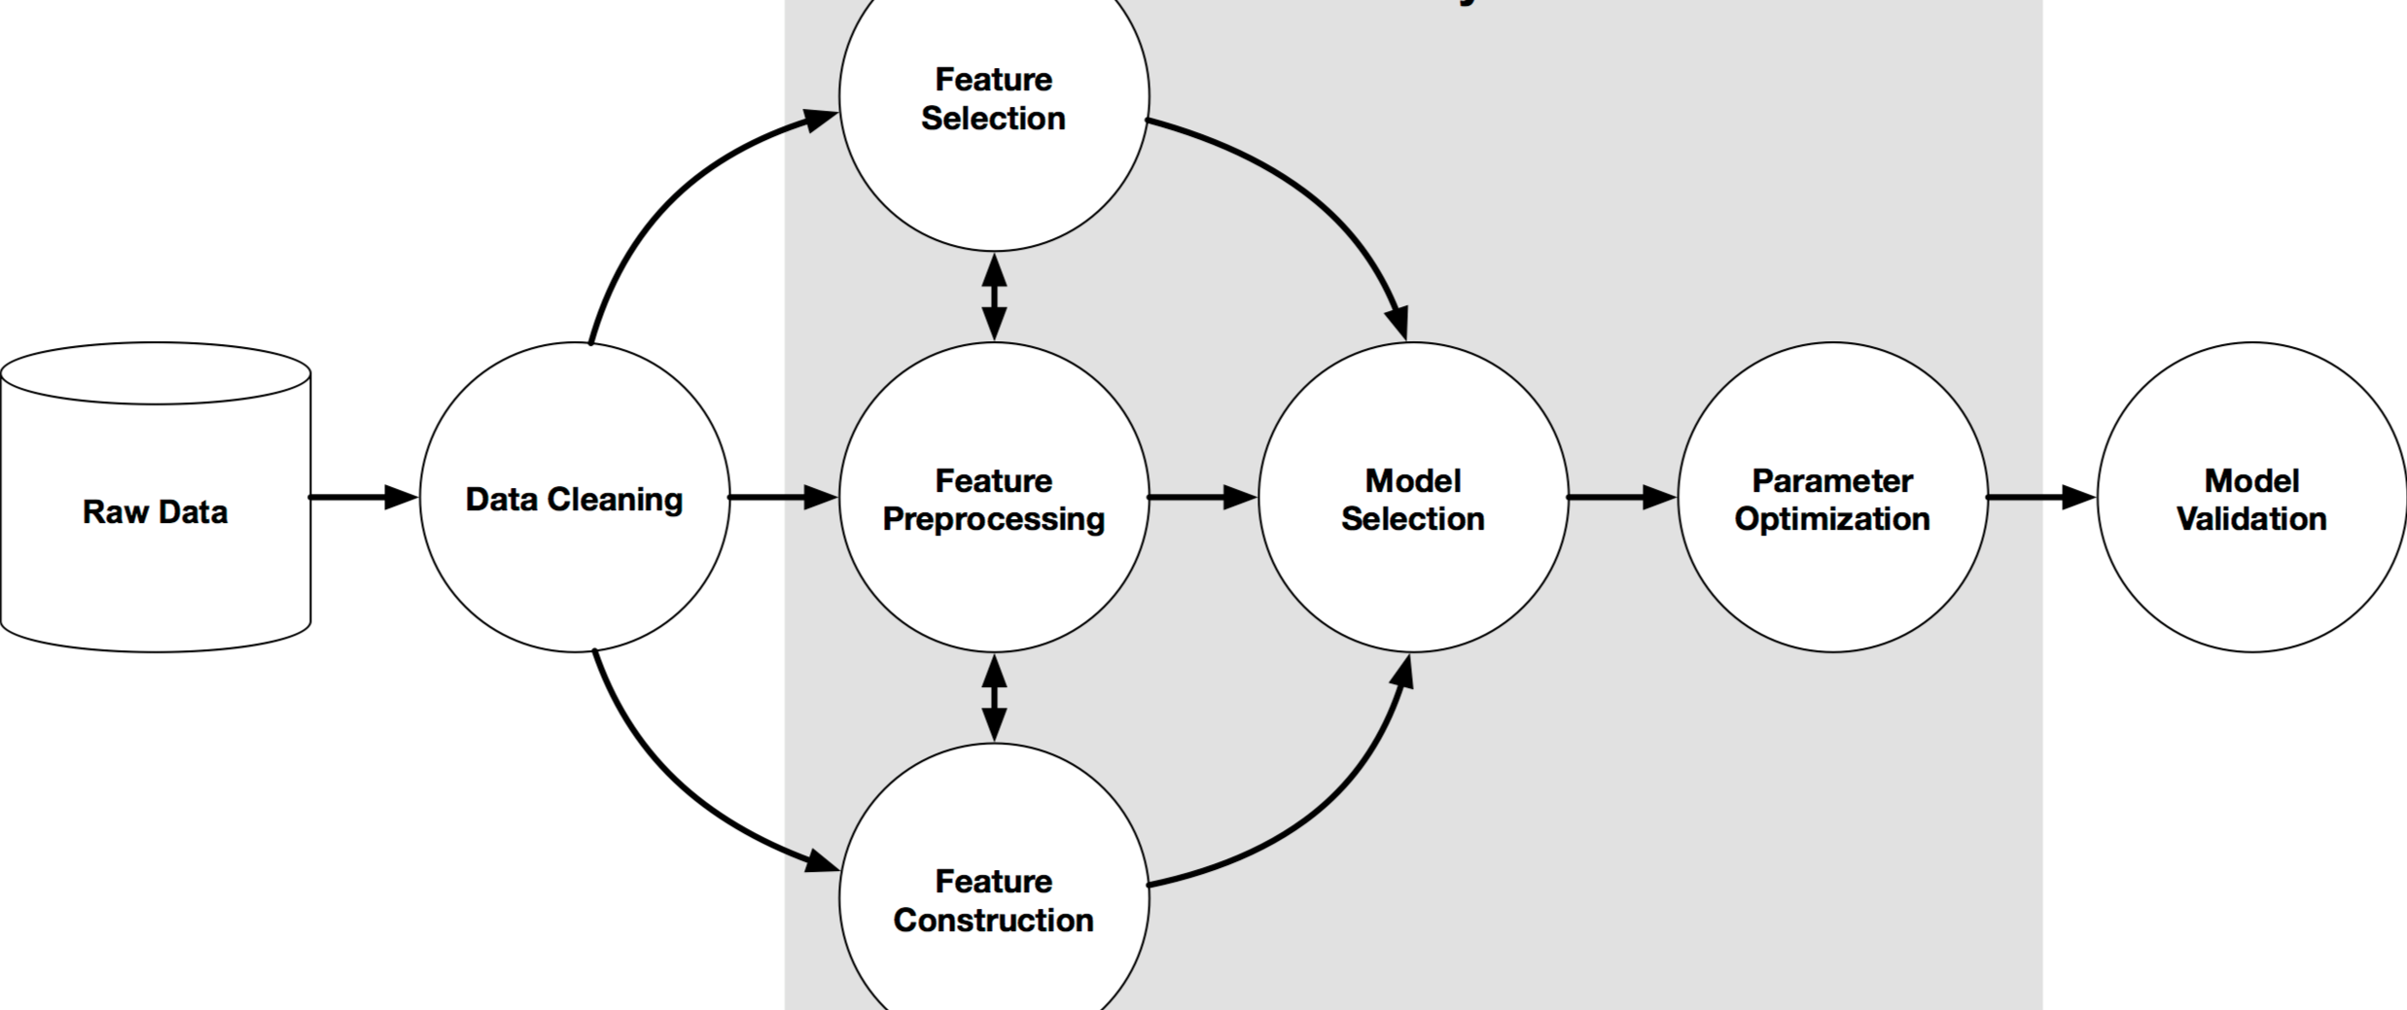
Methodology
*
<TITLE>
‹#›

Slide 7
Contribution of the Project
Innovativeness (Facial Recognition)
Usefulness (Good Management)
Market Potential (Google Photos)
*
<TITLE>
‹#›

Slide 8
Technical Details
Software Requirements:
Programming Language: Python 3
Libraries used: Tensorflow, Keras, numpy, sklearn
Hardware Requirements:
Intel Core i5 and above
16GB RAM (Min. 8GB)
Dedicated GPU
*
<TITLE>
‹#›

Slide 9
Why the particular technology is employed for this particular project.
The particular technology, i.e. Artificial Neural Networks is employed for this particular project. ANNs are much more capable of solving real world non-linear problems with great accuracy.
CNN is the best preferred technique (most efficient) for the image recognition and classification.
*
<TITLE>
‹#›

Slide 10
Expected Outcome
The Image Classifier model built using CNN will be able to classify images in a data set with great accuracy.
*
<TITLE>
‹#›

Slide 11
Profile of Team Members
Name:
Role:
Responsibility:
*
<TITLE>
‹#›

Slide 12
Reference
Neural Networks , Book by Simon S. Haykins
towardsdatascience.com
medium.com
analyticsvidhya.com
neuralnetworksanddeeplearning.com
github.com
*
<TITLE>
‹#›

Slide 13
Any Query Please..?
*
<TITLE>
‹#›

Slide 14
Thank You
*
<TITLE>
‹#›

